Slide 1
Use of MPP-Dairy vs. Other Margin Risk Management Systems: How Do They Compare? Prof. Brian W. Gould Department of Agricultural and Applied Economics University of Wisconsin-Madison University of Wisconsin Extension PowerPoint Presentation:
www.dairymarkets.og/MPP/PowerPoint/Option_LGM_MPP.pptx

Slide 2
MPP-Dairy and Use of Other Margin Risk Management Systems
MPP-Dairy enrollment: No impact on ability to use other risk management systems except for Livestock Gross Margin for Dairy (LGM)
Cannot participate in both programs
Use of LGM impacts procedures to enroll in MPP-Dairy if desired
Does impact complementary use of other systems

Slide 3
MPP-Dairy and Use of Other Margin Risk Management Systems
Can still
Forward contract farm milk with processor (except Class I) and purchased feed from supplier
Continue to use futures and/or options if desired
If use MPP-Dairy may want to protect
Additional milk component values: MPP-Dairy assumption that milk has average quality and price
Uninsured milk:
Slow APH growth starting after enrollment
90% maximum program coverage

Slide 4
Margin Risk Management: Options Based
Before we talk about MPP-Dairy and LGM lets quickly review a simple options based strategy for establishing an IOFC floor
Class III put: Establishes minimum milk value
Feed-based equivalent call: Establishes maximum feed cost ($/cwt milk)
Corn
SBM
i.e., Convert feed to corn and SBM equivalents

Slide 5
Margin Risk Management: Options Based
$/cwt
Milk revenue floor
$P* Class III Put
Strike Price→
IOFC** > IOFC < IOFC*
Min.
IOFC
IOFC*
$C* Feed Call
Strike Price→
IOFC**
Feed cost ceiling
$C*
$P*
Market Price/Cost ($/cwt milk)

Slide 6
Margin Risk Management: Options Based
Problems with this strategy
Could by expensive especially in volatile markets
For small operations, contract sizes may be problematic
200,000 & 100,000 lb – Class III (options)
‒ 110/55 cow herds assuming 22,000 lbs/cow
5,000 bu – Corn & Soybeans
100 tons – Soybean Meal
May not be able to undertake desired strategy due to relatively thin Class III options market
Someone must be willing to sell the put option

Slide 7
Margin Risk Management: LGM
MPP-Dairy sign-up:
Can sign-up anytime over life of Farm Bill during designated sign-up periods
After sign-up, enrolled until end of 2018
Before initial sign-up producers may want to evaluate merits of MPP-Dairy vs. LGM
Lets quickly review LGM and then compare each programs’ characteristics

Slide 8
LGM: An Overview
LGM used to manage IOFC volatility
Establishes minimum IOFC similar to above put/call options strategy
No options actually purchased
Markets only used as information source
No minimum size limit unlike options contracts
Coverage Upper limit: 240,000 cwt over 10 mo. or within a single insurance year
Premium not due until after 11-month insurance period regardless of number of insured months
Known subsidized producer premiums and direct payments to insurance providers

Slide 9
LGM: An Overview
LGM is customizable with respect to:
Number of months insured by a contract: 1 – 10
% of monthly marketings insured: 0 – 100%
% insured can vary across month
Deductible chosen: $0 −$2.00/cwt
Amt. margin falls below target before indemnity created
Direct producer premium subsidy: 18% – 50%
Subsidy increases with higher deductible
Program declared ration
Given the above → farm specific premiums

Slide 10
LGM: An Overview
If insured margin greater than actual margin for entire contract → indemnity forthcoming
Insured margin = select total contract margin − deductible ($/cwt)
Indemnity amount = Insured − actual margin
Only one indemnity calculation per contract regardless of contract length
Indemnity determination made after last actual contract price published by RMA regardless of contract length

Slide 11
LGM: An Overview
LGM purchased on last business Friday of each month if funds available
Friday, 4:30 PM (Central) → 8:00 PM Saturday
Potential for 12 contract offerings/year
Multiple contracts can cover milk marketings in months previously protected
Total coverage can not exceed 100% of an operation’s approved maximum target marketings for that particular month

Slide 12
Comparison of MPP-Dairy and LGM
How do MPP-Dairy and LGM compare?
Is sign-up mandatory?
MPP-Dairy | LGM
Program is voluntary | Program is voluntary
Can a producer purchase both MPP-Dairy and LGM ?
MPP-Dairy | LGM
Not Allowed once signed up | -------

Slide 13
Comparison of MPP-Dairy and LGM
What is the range of margins protected?
MPP-Dairy | LGM
Margin range: $4 to $8/cwt in $0.50 increments Range does not change with milk or feed market conditions | Infinite coverage levels Determined by futures market settlement prices at sign-up
What is the contract coverage period?
MPP-Dairy | LGM
Annual if existing producer Prorated for new operation or 2014/15 transitioning LGM user | Producer determined 2 – 11 months after purchase

Slide 14
Comparison of MPP-Dairy and LGM
When can contracts be purchased?
MPP-Dairy | LGM
May be purchased once a year during designated sign-up period 2014−15: Sep 2nd – Nov 28th 2014 2016−18: June 1 – Last business day of August Once signed-up, in program until end of 2018 | Offered last business Friday monthly starting at 4:30 CDT Producers may sign up 12 times per year given funding availability Offered on first come, first served basis

Slide 15
Comparison of MPP-Dairy and LGM
How much milk can be insured?
MPP-Dairy | LGM
25% − 90% of operation’s APH Annual increase in APH equals aggregate dairy industry growth rate % of milk covered is the same for all months | 0% – 100% approved target marketings No growth limit on insured milk marketings % milk covered can vary across months Multiple contracts can be used to cover a month’s marketings until 100% insured if desired

Slide 16
Comparison of MPP-Dairy and LGM
When are payments/indemnities determined?
MPP-Dairy | LGM
Six bimonthly payment determinations: Jan/Feb Mar/Apr May/Jun Jul/Aug Sept/Oct Nov/Dec | Only 1 indemnity determined per contract regardless of length After last insured month’s actual price announced Period varies with contract specification and months insured

Slide 17
Comparison of MPP-Dairy and LGM
How do premiums compare?
MPP-Dairy | LGM
Fixed rate schedule 25% discount for 2014/15 Vary with (i) margin protected and (ii) milk amount insured → Same premium for same margin target and premium tier for entire 2014 Farm Bill life Do not change with market conditions | Designed to be actuarially fair Premium = 1.03 times expected indemnity at signup Premium independent of insured amt. Vary with (i) market conditions; (ii) declared ration; (iii) deductible; and (iv) margin protected → Premiums vary across farms and over time for same margin → May change with market conditions, ceteris paribus, for same margin target

Slide 18
Comparison of MPP-Dairy and LGM
To what degree are these programs subsidized?
MPP-Dairy | LGM
100% subsidy @ $4.00/cwt > $4.00: Implicit subsidy depends on milk/feed markets Program not self-financing Subsidy changes given market conditions, margin target and APH | Premiums subsidized where % subsidy depends on deductible $0 → 18% $1.00 → 48% $2.00 → 50% Additional subsidy for A&O to insurance providers: Approx. 20% of pre-subsidized premium

Slide 19
Comparison of MPP-Dairy and LGM
When are user fees/premiums due?
MPP-Dairy | LGM
2 alternatives: 100% at sign-up; or 25% min. at sign-up, remainder by June 30th of insured year Fees subtracted from any forthcoming payment | Premium due 11 months after purchase regardless of contract length Premium subtracted from any forthcoming indemnity

Slide 20
Comparison of MPP-Dairy and LGM
What are program feed ration characteristics?
MPP-Dairy | LGM
Fixed feed ration All months All operations Feed costs still vary monthly All feed assumed purchased | Operation specific rations May include only purchased feed if desired Ration can vary across months under a single contract → $Cost/cwt may vary across months within a contract

Slide 21
Comparison of MPP-Dairy and LGM
What prices are used in program calculations?
MPP-Dairy | LGM
Average U.S. price received for All-Milk, Corn, and Alfalfa Hay (USDA, Ag Prices Report) Only final prices used SBM valued at Central Illinois /Decatur (Rail) reported by USDA, AMS | Simple 3-day average of CME futures final daily settlement prices for Class III milk, Corn, and SBM Expected prices: Calculated at sign-up Actual prices: Set when futures contracts expire

Slide 22
Comparison of MPP-Dairy and LGM
How can LGM (MPP-Dairy) user’s transition to use of MPP-Dairy (LGM)?
MPP-Dairy | LGM
Once purchased, MPP-Dairy contract holders cannot purchase LGM | 2014/15: Contract holders can transition to MPP-Dairy with coverage starting after fulfilling LGM contract After 2015: Cannot have active LGM contract for months covered by desired MPP-Dairy contract (i.e., entire year)

Slide 23
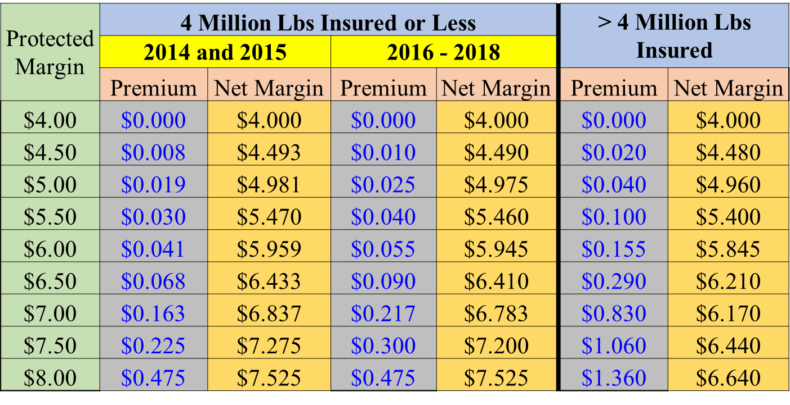
Use of MPP-Dairy and Other Risk Management Tools
Factors when choosing use of MPP-Dairy and other margin risk management systems:
How much protection do you need?
If need more protection than offered via MPP-Dairy may need to consider other risk management systems
Herd expansion
High component milk
What is the cost?

Slide 24
Use of MPP-Dairy and Other Risk Management Tools
Factors when choosing use of MPP-Dairy and other margin risk management systems:
What is farm’s margin basis and basis volatility?
What is the relationship between a farm’s mailbox margin and USDA’s value?
If need $6.50 on-farm margin to cover variable costs how does this translate to MPP-Dairy margin: $7.50, $5.75, etc. ?
How likely a farm’s margin declines much more than USDA benchmark margin?

Slide 25
Contact Information
Professor Brian W. Gould
bwgould@wisc.edu
(608)263-3212
Dairy Marketing and Policy (DMaP) group MPP-Dairy website:
www.dairymarkets.org/mpp

